Slide 1

CST-361 Design Patterns in Java
cameron deao
David cho
Emily Quevedo

Slide 2
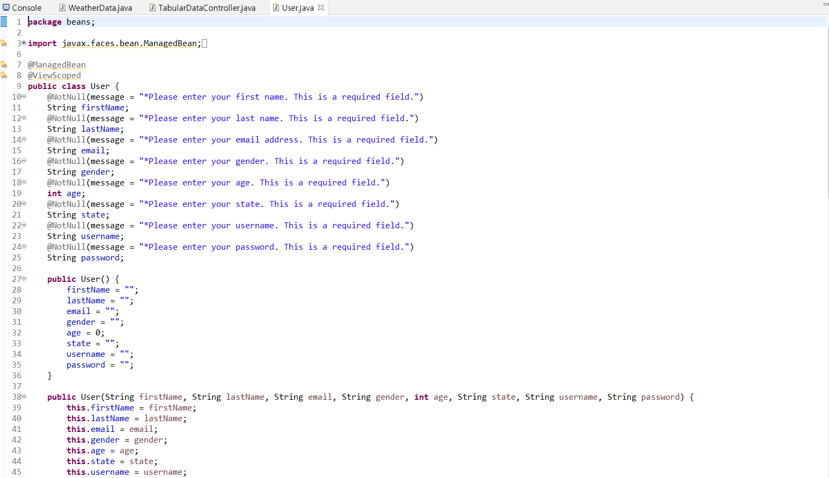
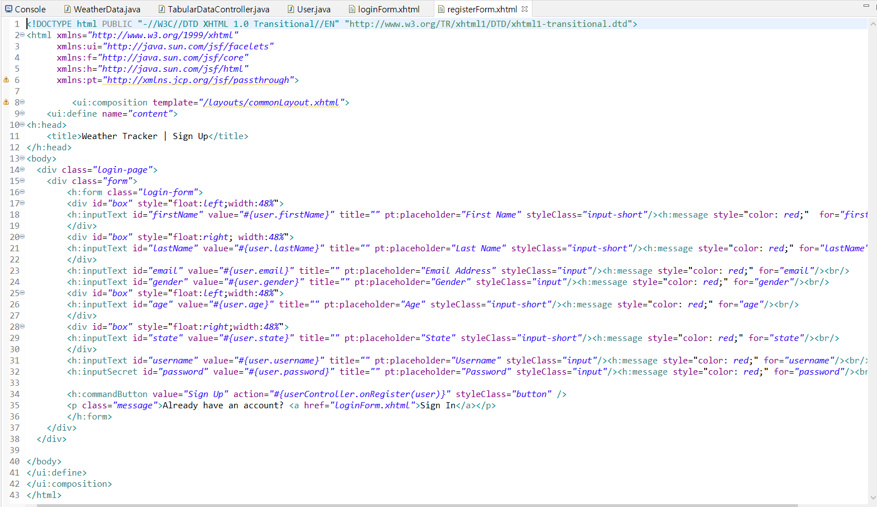
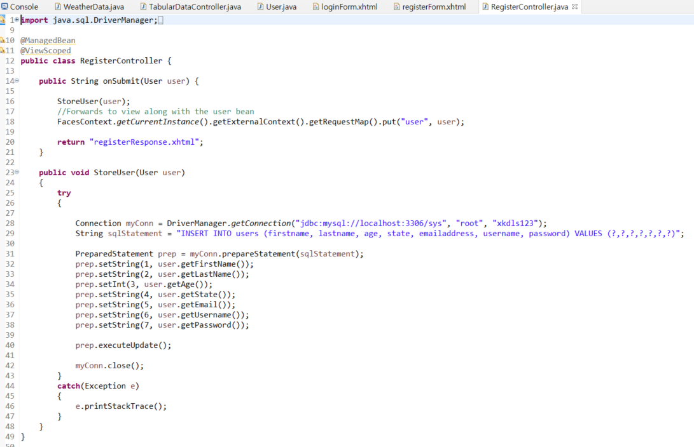
MVC Design Pattern
Model
View
Controller
Notes:
The model-view-controller (MVC) design pattern specifies that an application consist of a data model, presentation information, and control information. The pattern requires that each of these be separated into different objects.

Slide 3
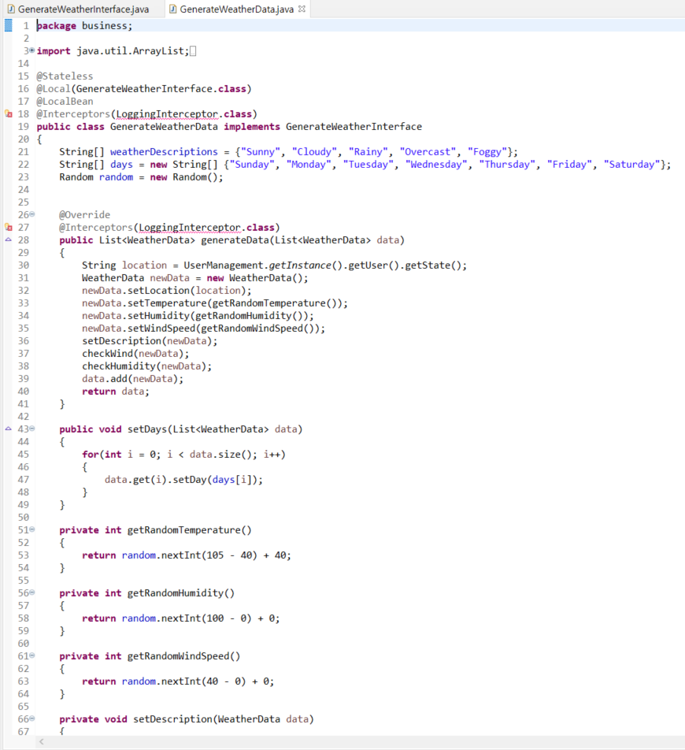
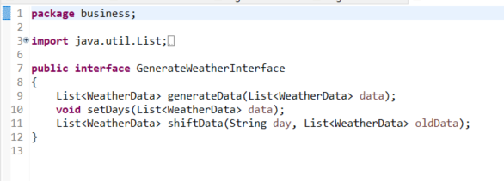
Façade Design Pattern
Façade class
Interface
Notes:
Facade pattern hides the complexities of the system and provides an interface to the client using which the client can access the system. This type of design pattern comes under structural pattern as this pattern adds an interface to existing system to hide its complexities.

Slide 4
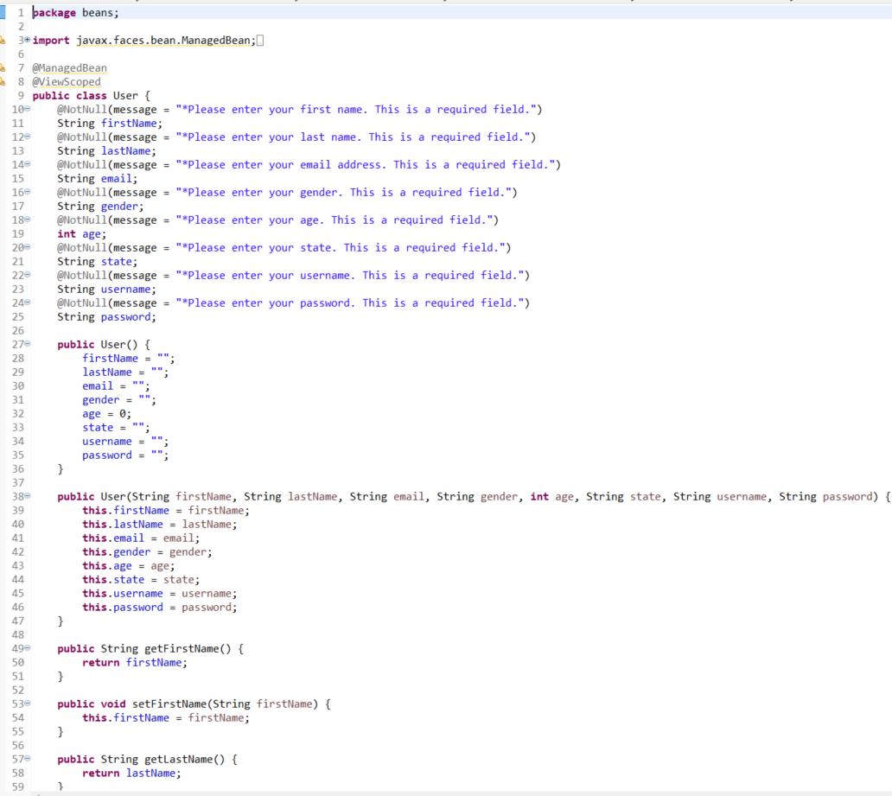
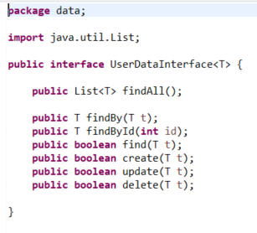
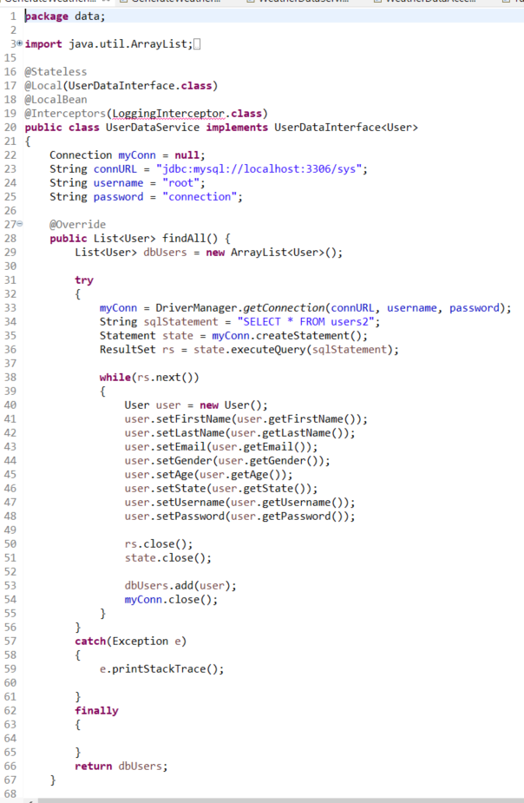
DAO Design Pattern
Notes:
Data Access Object Pattern or DAO pattern is used to separate low level data accessing API or operations from high level business services.

Slide 5
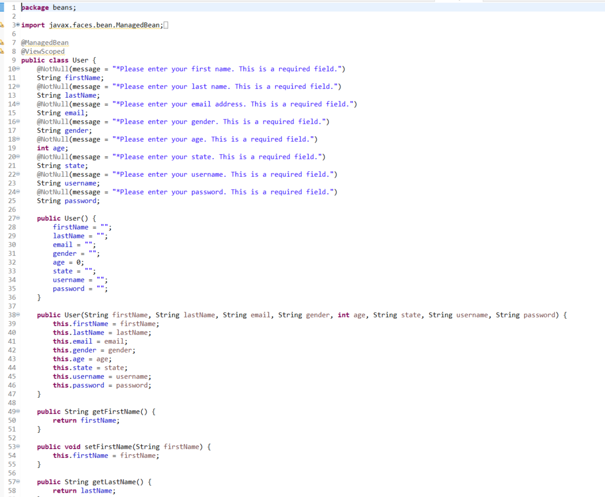
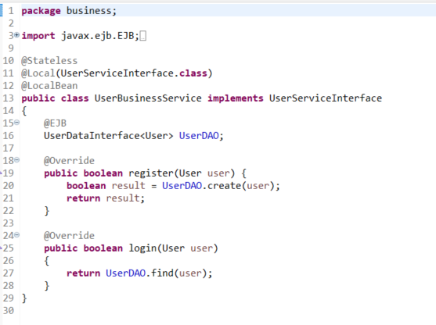
DTO design pattern
Notes:
The Transfer Object pattern is used when we want to pass data with multiple attributes in one shot from client to server. Transfer object is also known as Value Object. Transfer Object is a simple POJO class having getter/setter methods and is serializable so that it can be transferred over the network.

Slide 6
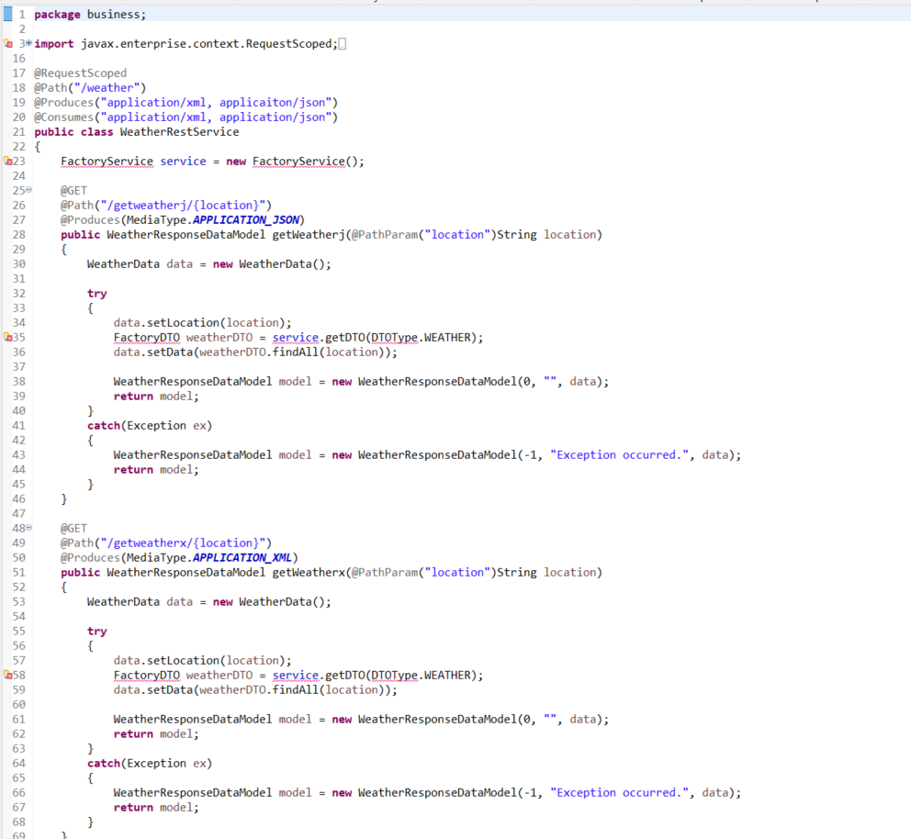
RESTful Api pattern
Notes:
An API is all about resource and interaction. A resource can have all or some of the basic operations that allow a client to interact with it. A client can create, replace, update, delete and retrieve a resource.

Slide 7
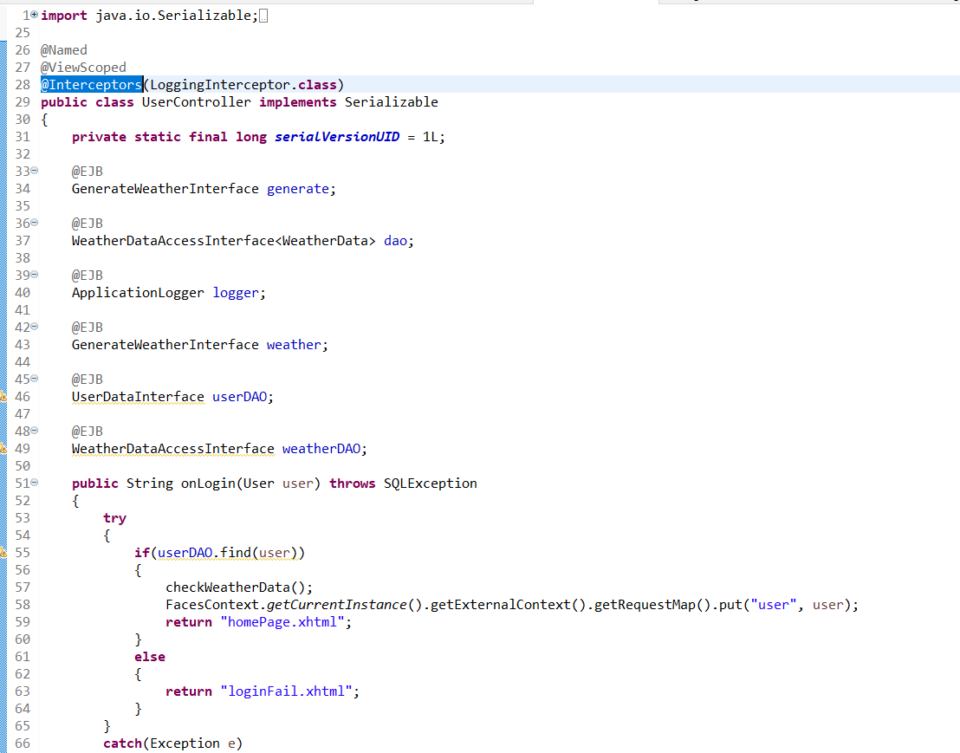
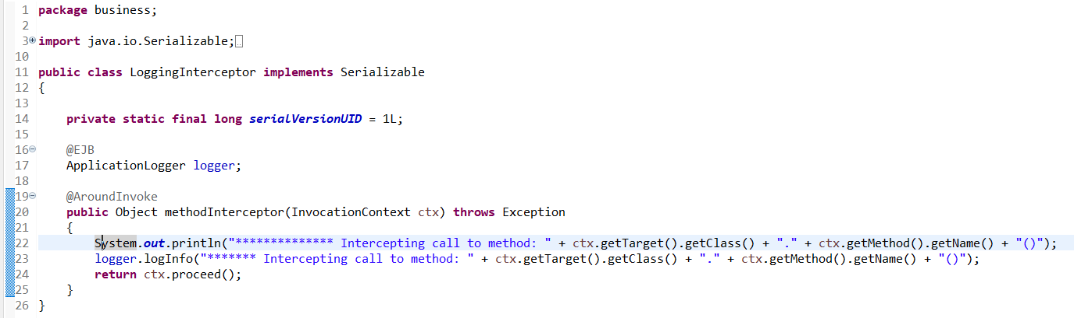
Interceptor design pattern

Slide 8
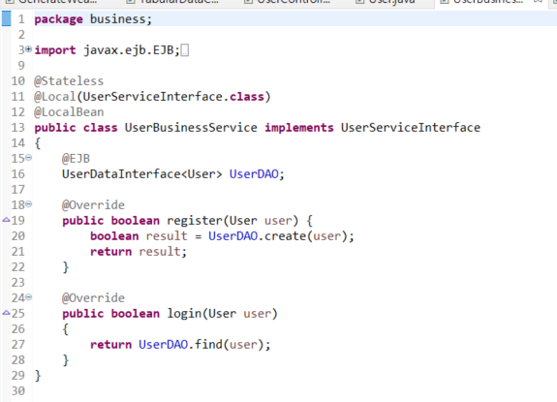
Dependency injection design pattern
Notes:
Dependency Injection (DI) is a design pattern used to implement IoC. It allows the creation of dependent objects outside of a class and provides those objects to a class through different ways.

Slide 9
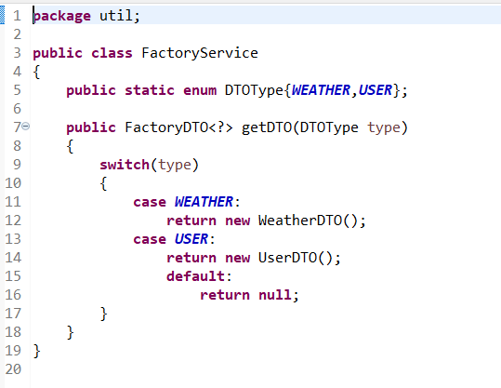
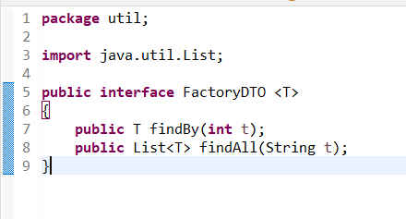
Factory design pattern
Notes:
Factory pattern is one of the most used design patterns in Java. This type of design pattern comes under creational pattern as this pattern provides one of the best ways to create an object.
In Factory pattern, we create object without exposing the creation logic to the client and refer to newly created object using a common interface.

Slide 10
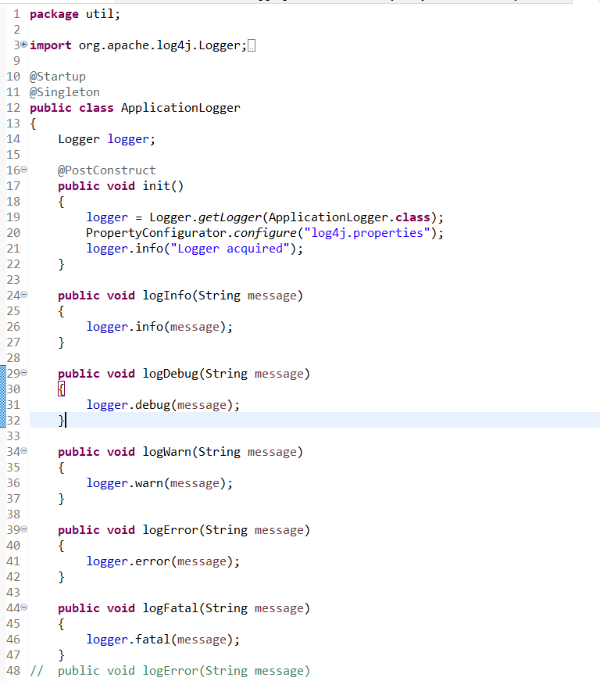
Singleton design pattern

